Slide 1

National Development
Finance Agency
Overview of Public Private Partnership (PPP) Projects in the Education Sector
PPP Investment Forum – Kazakhstan PPP Centre
October 2020
Susanne Fitzpatrick & Eamonn Halpin, NDFA
Elaine McWeeney, Department of Education

Slide 2

Agenda
National Development Finance Agency (NDFA)
Characteristics of our Education PPP Projects
Value for Money Overview
Example of a Project & Procurement
Higher Education PPP Programme
2

Slide 3
NDFA - What We Do
  Capital projects >€20m
  EIB/CEB funding arranger
  Financial Advisor, Procurement & Delivery Authority
Financial Advisor
30+ Projects
€5.7bn
Financial Advice
PPP Delivery
Infrastructure
Delivery
13 Projects
€1.7bn
Direct State Funded Infrastructure
Contract Management and Advisory Services
  Exchequer
  funded Projects:
  Financial Advisor, Procurement & Delivery Authority
  Operational PPP,
  Bespoke advisory: housing
October 2020
3

Slide 4
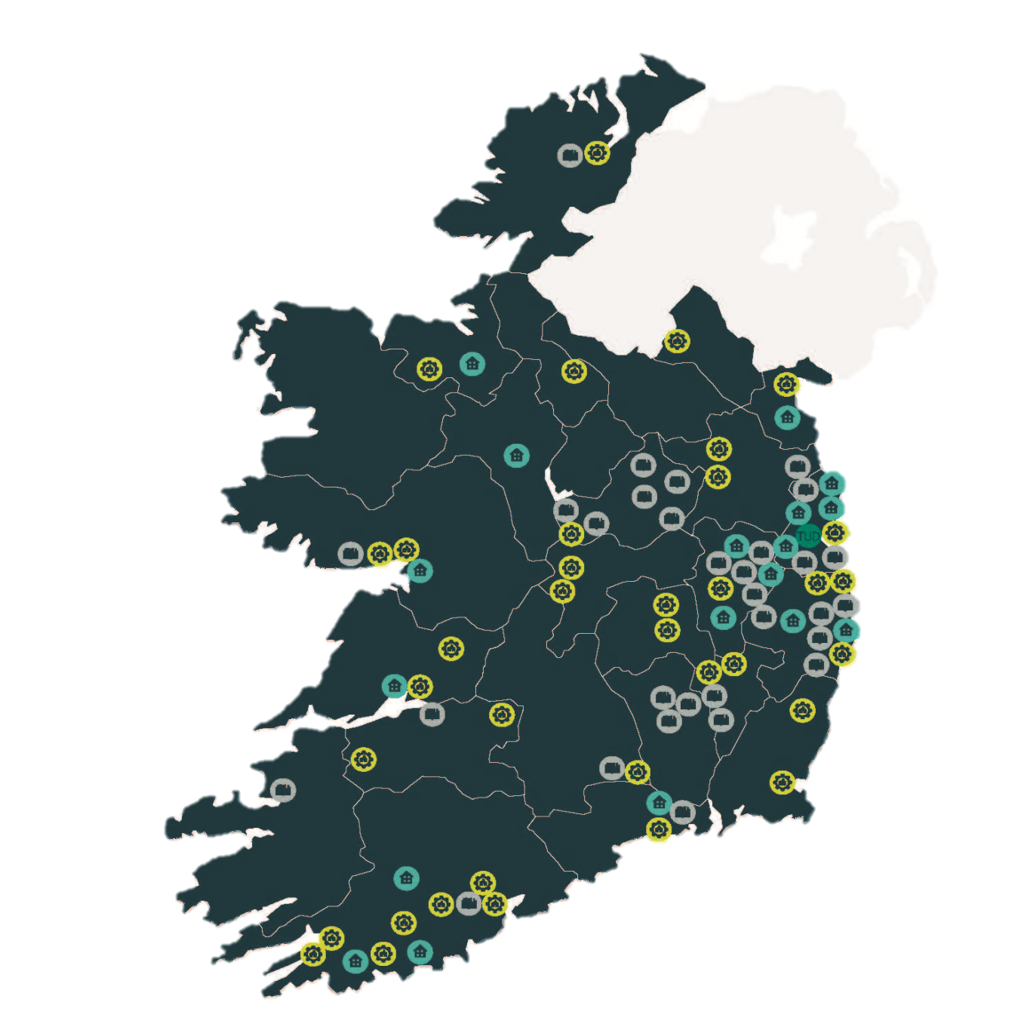




Current Project Delivery Status -
NDFA - Regional Impact
39
Operational facilities
13
Live sites
37
Sites in planning & procurement
Schools & Higher Education Facilities
TU Dublin Campus
Grangegorman
Social Housing
Operational Facilities
October 2020
4

Slide 5
Characteristics of our Education PPP Projects
Key Characteristics
DBFMO by Private Partner
Asset built and maintained on state owned sites
Contract Term
Construction +25 years
Construction & services
Handed back in good condition
Payment Method
Monthly Unitary Charge or User Charges
Availability (& Performance based)
Financing
Private Debt & Equity
Repaid over 25 years
Off balance sheet

Slide 6
Typical PPP Contract Structure
NDFA (Public Authority)
Independent Tester
Sponsor(s)
Equity
PPP Co. (SPV)
Debt
Lender(s)
Constructor
Operator

Slide 7
Contract/Deal Structure – Risk Transfer & Balance Sheet Treatment
Eurostat balance sheet rules apply
Must effect genuine risk & reward transfer (economic ownership) to private partner e.g. payment at risk
Achieved in ‘availability model’ by transfer of Construction and Availability Risk
  Construction Risk Fixed price construction contract penalties
  Availability Risk Unitary Charge deductions if accommodation not available or services not performed to standard
  Hand Back Risk Accommodation must be returned to a pre-defined standard
7

Slide 8






PPP Project delivery
Project Appraisal / OBC
Project Development
Procurement
Operations
Construction
Financial Close

Slide 9
Value for Money Overview
Planning
(Pre Procurement)
Preliminary and/or detailed appraisal undertaken (inc. PPP assessment)
Project mgt. structures established
Implementation (Procurement)
Pre Qualification & short-listing
Tender process
Delivery
Contract management
Compile output specifications & PSB
Tender evaluation
Award of Contract
Financial Close
VfM test 1: pre PSB *
VfM test 2: Should project still proceed as a PPP?**
VfM test 3: Does highest ranking tender have potential to deliver VfM?
VfM test 4: Impact of changes pre financial close
* Prepared by Sponsoring Agency – is project of sufficient scale/risk to justify PPP etc.
** In light of PSB quantifications – e.g. whether level of risk transfer is sufficient to justify cost of private finance

Slide 10
Value for Money – Public Sector Benchmark (PSB)
“The project budget”
A risk adjusted full cost budget for the construction & 25 year operating period expressed as a single net present value (NPV) figure
Based on a ‘traditional’ procurement BUT captures what private sector is invited to Tender for
Why prepare a PSB?
    Detailed framework to govern / support decision making
    Tender assessment VfM benchmark
10

Slide 11
VfM Overview – Costs Included
Base Costs
Capital, operating & maintenance and lifecycle costs (including spend profiles).
Third Party Income
Constitutes income generated by third parties for use of the asset / service.
Risk Analysis
Risks identified by project team and distilled in risk register.
Derived by technical (and insurance) advisors based on output specifications of what the Sponsoring Agency seeks to achieve.
Generally not applicable for accommodation based projects – toll road schemes primary example.
Risk identified by category (e.g. planning, construction) and owner (retained, transferred, shared).
Only transferred risk and portion of shared risks transferred are included in the PSB.
11

Slide 12
Education PPP Programme – Overview
Construction phase
Technological University Dublin campus at Grangegorman - Central & East Quad Project
Operations phase
Pilot Schools (2003)
National Maritime College (2004)
Cork School of Music (2007)
Schools Bundles 1 (2010), 2 (2011), 3 (2014), 4 (2016) & 5 (2019)
Procurement phase
Higher Education Bundle 1
Higher Education Bundle 2
12

Slide 13
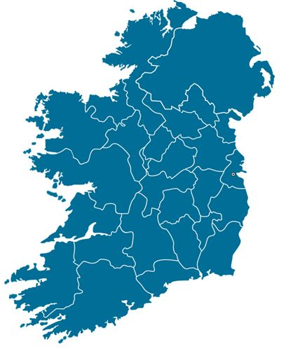

Case Study – Higher Education PPP Programme
11 Higher Education specialist facilities
C. €300-€400m capex
Will facilitate 8,000 additional students
Estimated completion 2024
 | Bundle 1 | Bundle 2
Size (m2) | 38,325 | 29,552
Sites per bundle | 6 | 5
Institutes of Technology | Athlone Cork IADT Tralee TU Dublin x 2 | Carlow Galway/Mayo Letterkenny Limerick Waterford

Slide 14
Higher Education PPP Programme – Overview: Delivery Process
Statutory compliance process
Public sector benchmark
Define requirements (Accommodation / Services)
Site selection
Planning & Appraisal
Financial Close
Evaluation of submitted tenders and selection of a preferred tenderer
Tender process (including a number of consultation / dialogue meetings)
Prequalification of candidates
Procurement
Monthly PPP Co. report and progress meeting
Accommodation available / services provided in accordance with the contract
Service Period
Monthly PPP Co. report and progress meeting
Construction
Agree service delivery plans for service period
Testing and commissioning process
Construction in accordance with programme
5 yearly benchmarking / marketing testing of selected services
Handback process
14
Notes:
(

Slide 15
Higher Education PPP Programme – The Project Board
Project Board
Comprises Representatives of the Department of Education & Skills and the NDFA
PB Chair (Dept. Education): Planning/Pre-Procurement
Process Auditor
Supports Accountable Officer in ensuring procedures and processes have been followed
Project Advisors
Project Management (NDFA)
Financial Advisor (NDFA)
Legal Advisor (Appointed by NDFA)
Architect / Civil / Structural Engineer / M&E Engineer / Quantity Surveyor (Appointed by NDFA)
PB Chair (NDFA): Procurement & Implementation Phases
15

Slide 16
Useful Resources
NDFA
www.ndfa.ie
Department of Public Expenditure & Reform
www.ppp.gov.ie
Public Spending Code
https://publicspendingcode.per.gov.ie/
16

Slide 17
Any questions?

